Slide 1
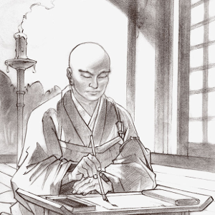
How do we know if chanting Nam-Myoho-Renge-Kyo to the Gohonzon works?
What is the key to promoting unity and diversity?
The bond of mentor and disciple – what does it mean to you?

Slide 2
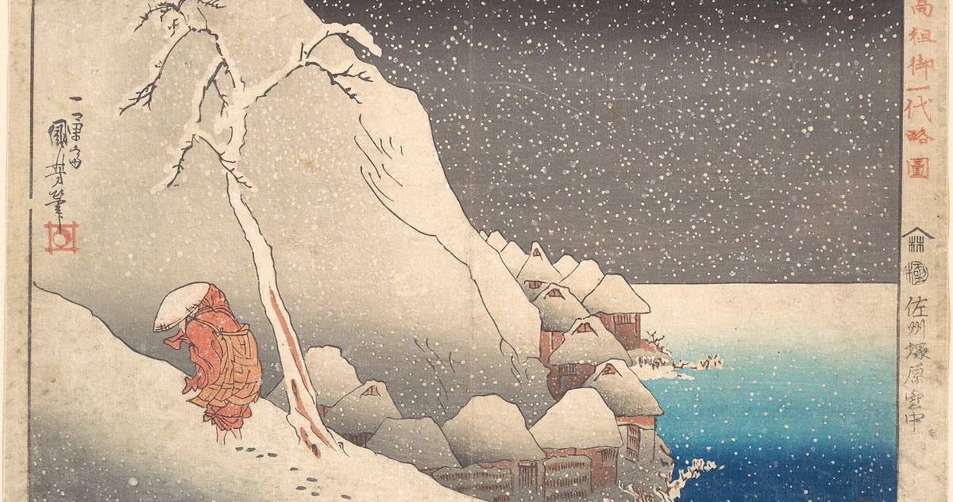
All disciples and lay supporters of Nichiren should chant Nam-myoho-renge-kyo with the spirit of many-in-body but one-in-mind, transcending all differences among themselves to become inseparable as fish and the water in which they swim.
This spiritual bond is the basis for the universal transmission of the ultimate Law if life and death.
Herein lies the true goal of Nichiren’s propagation. When you are so united, even the great desire for widespread propagation (or the great vow for kosen-rufu) can be fulfilled.

Slide 3
What happen when we chant Nam-Myoho-Renge-Kyo
It fills us with the energy to face every difficult situation;
Strengthens our life force and makes us unbeatable;
It enables us to exercise our wisdom and intellect;
Sets us on a sure path leading to good fortune and benefit;
Allow us to advance to victory

Slide 4
How do we inherit the Heritage of the Ultimate Law of Life and Death
Having the conviction in the truth that our lives are one with the Mystic Law
Maintain steadfast and unwavering faith that never forsakes the Mystic Law in any lifetime whatsoever throughout eternity
Unity of many in body and one in mind

Slide 5
What is the proper attitude of disciples working for kosen-rufu
Transcend all differences among themselves
Become inseparable as fish and water
Work together with the spirit of many in body but one in mind

Slide 6
What does transcending all differences among themselves means?
Eliminating any feelings of discrimination or antagonism (hostility)
Making constant effort to surmount the human tendency toward self-centredness.

Slide 7
What does becoming inseparable as fish and water in which they swim together means?
We can achieve great things together by respecting one another as irreplaceably precious
Supporting and trusting each other

Slide 8
What does many in body but one in mind means?
Many in body means that everyone has a unique personality, culture, qualities and circumstances
One in mind means that we share a common sense of purpose and values
Together it means we need to make the most of our diversity, encourage one another and achieve our shared goal of kosen-rufu.

Slide 9
How do we know if chanting Nam-Myoho-Renge-Kyo to the Gohonzon works?
What is the key to promoting unity and diversity?
The bond of mentor and disciple – what does it mean to you?

